Slide 1
Text Extraction from Geological Documents
Shubham Biswas
Maria Terrah

Slide 2
Context and aim of project
Extraction of formation description from geological documents
Extract text from scanned PDF files in an efficient way
Use of OCR techniques and tools : TESSERACT OCR
Finding insights from the extracted text

Slide 3
Main steps of the work
Table Detection
Image Pre-processing
Text Extraction
Text Correction
Topic Analysis

Slide 4





Tools
Tesseract is an open source text recognition (OCR) Engine, available under the Apache 2.0 license. It can be used directly, or (for programmers) using an API to extract printed text from images. It supports a wide variety of languages.
Pillow is the Python Imaging Library (abbreviated as PIL) is a library for Python that adds support for opening, manipulating and saving many different image file formats.
It was used for image manipulation and processing.
TextBlob is a an NLP Python library , built on top of NLTK for processing textual data.
It was used on the spelling correction module to correct spellings mistakes produced after the extraction.
Apache Spark is a unified analytics engine for big data processing, with built-in modules for streaming, SQL, machine learning and graph processing. It was used on the topic analysis module to create input RDDs.
OpenCV is a library of programming functions mainly aimed at real-time computer vision.
It was used for Image preprocessing tasks

Slide 5
Global Architecture
Input Documents
Table detection
Extracted text after image pre-processing
Image Pre-processing
outputs
Post-processing steps
Text after spelling correction
Text correction
outputs
Information about the text data
Topic Analysis
outputs
Notes:
Include a flowchart
In the following slides, take an example sentence and demonstrate what happens when it goes through

Slide 6

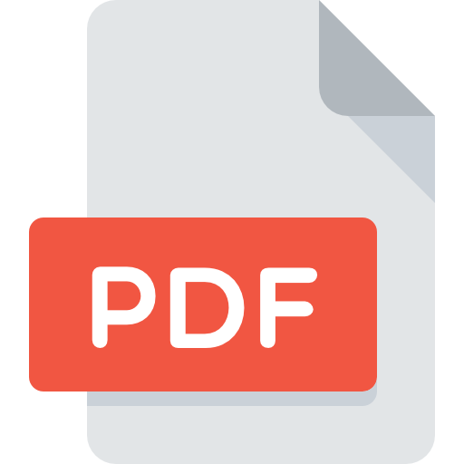

Before the image preprocessing
Used a python library : pdf2image
N images
N pages

Slide 7
Table Detection in Image
Detect the cells that are the horizontal and vertical lines.
Convert the image to binary and turn them into grayscale with OpenCV.
Define two kernels to extract the horizontal and vertical lines

Slide 8
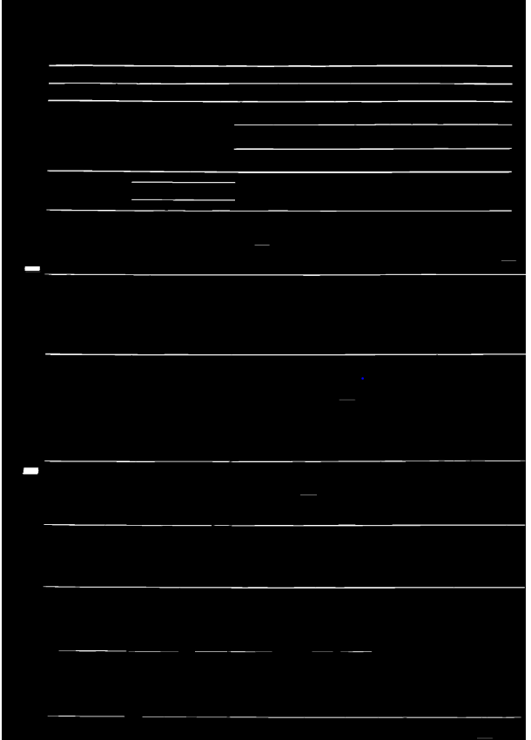
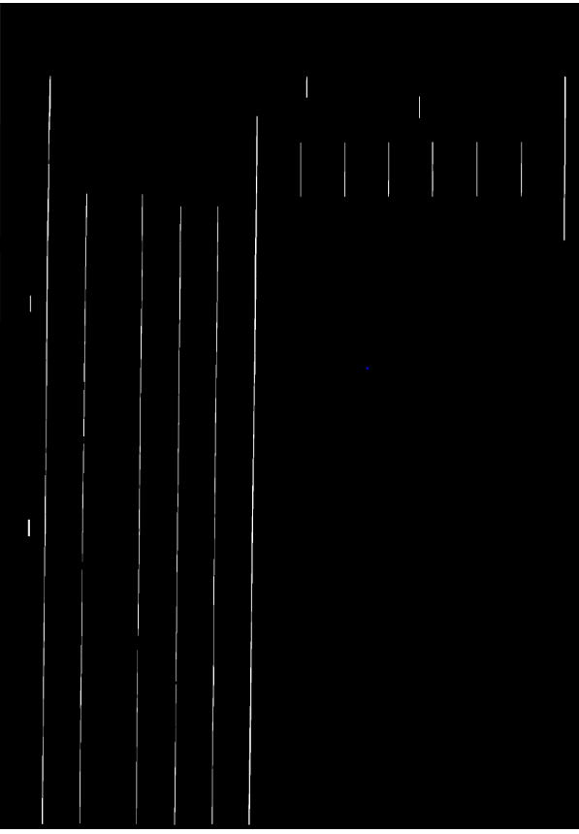
Table Detection in Image
Functions to detect lines in an image:
erode - all the pixels near boundary will be discarded depending upon the size of kernel
dilate - a pixel element is ‘1’ if atleast one pixel under the kernel is ‘1’
getStructuringElement - structure the shape and size of the kernel, in our case it is rectangle

Slide 9
Bounding cell detection
We use Contours to highlight the cells created by the horizontal and vertical lines.
Contours - curve joining all the continuous points (along the boundary),
Retrieve the four side dimensions of the contours
Filter images on the basis of the detected cells

Slide 10
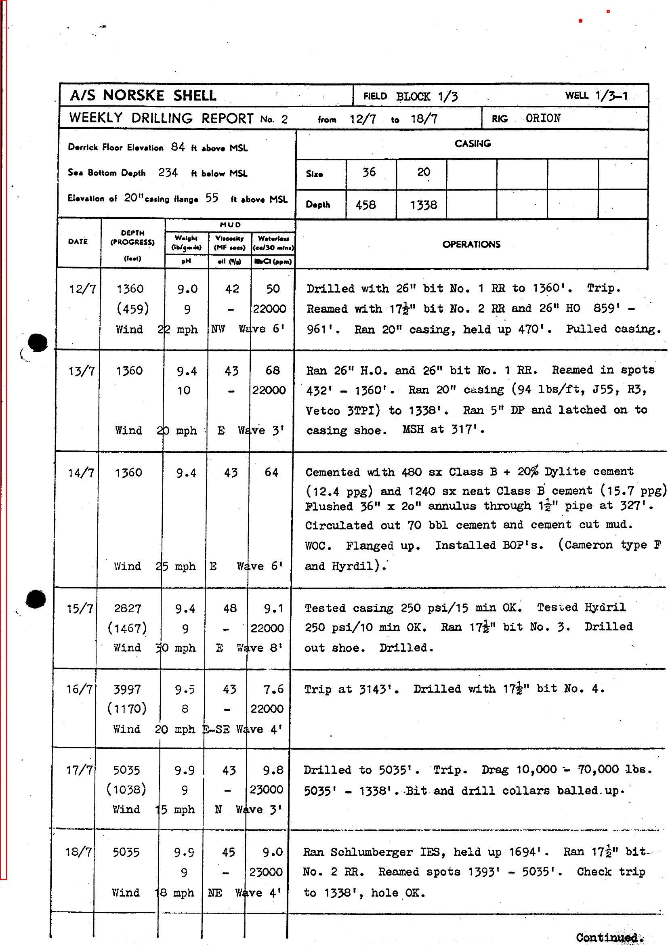
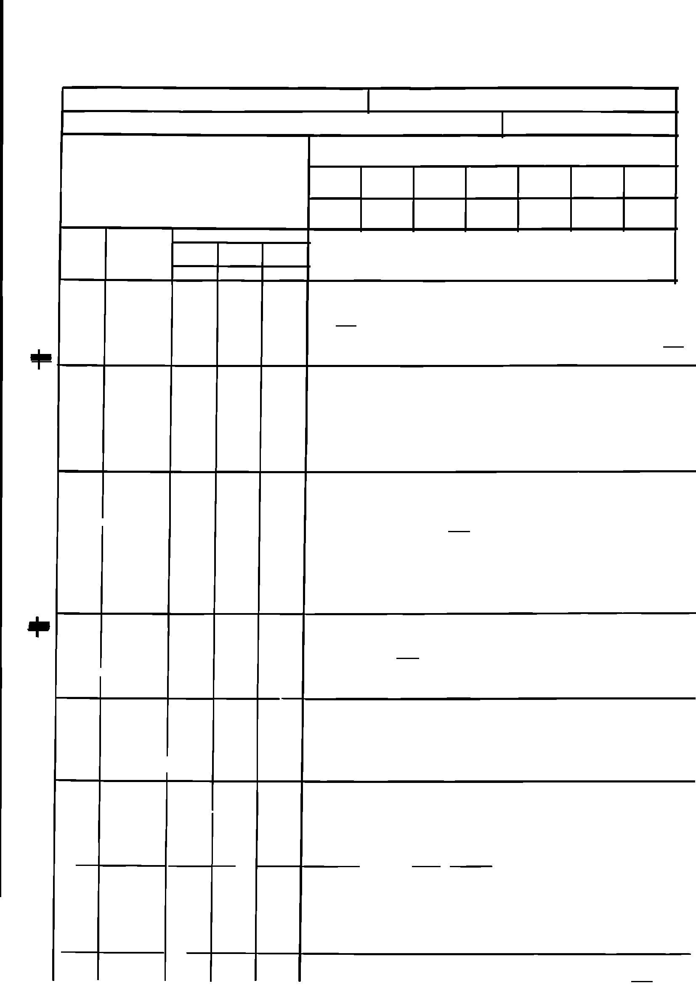
Table Detection in Image
Detection of vertical and horizontal lines:

Slide 11
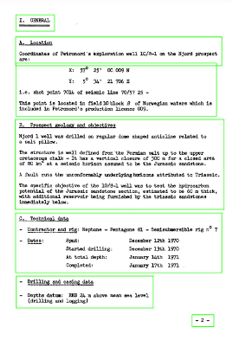
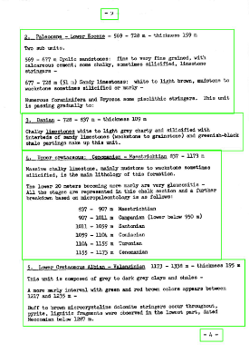
Section detection
Using Open CV
Gaussian Blur and Adaptive threshold
Adaptive threshold
Dilation
Contouring

Slide 12
Image Preprocessing
Why ?
Avoid errors : misspelled characters (substitutions), spurious symbols (insertions), lost or missing text (deletions).
Improve OCR extraction
Achieve higher extraction accuracy and therefore better results

Slide 13
Preprocessing the Image
Thresholding : Otsu’s Algorithm
Noise removal : adaptive Gaussian (5,5) kernel
Skew Detection/Correction : Projection Profile Method
Quality of image preprocessing : Structural Similarity Index

Slide 14

Extract Text from Images
Used a python library : pytesseract
Python-tesseract or pytesseract is an optical character recognition (OCR) tool for python used to recognize and read the text embedded in images.
N images
N text files

Slide 15
Text Correction
Uses the NLTK corpus
1. Identify the misspelled tokens : as example a misspelled word w
2. Compare the word w with the candidate words in the dictionary of words :
Example : w=‘lates’ , candidate words = [ ‘late’ , ‘latest’ , ‘lattes’]
3. Choose the correction c that maximizes the probability p(c|w)
4. Update the text by substituting the chosen correction c to the word w

Slide 16
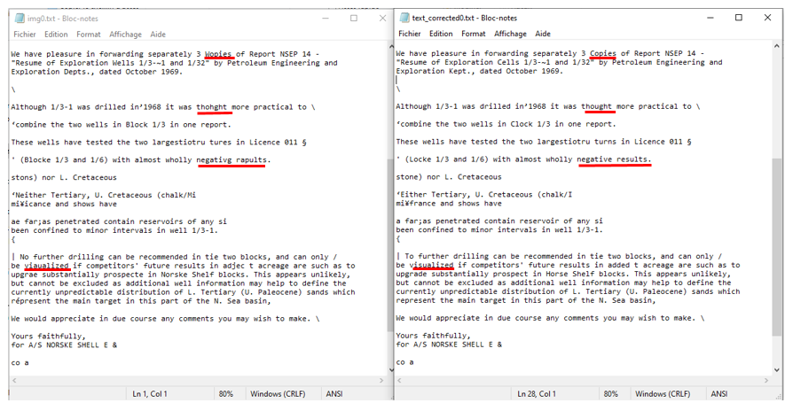
Text Correction Results

Slide 17
Text Correction Results
Average percentage(%) of corrected mistakes =
sum( percentage of corrected mistakes in each page)
/ number of pages
Document | Average % of corrected mistakes
Document 1 | 19,62
Document 2 | 21,52
Document 3 | 22,93
Document 4 | 12,67
Document 5 | 24,19
Main challenges :
Existence of rare words in the documents ( the geological technical words , proper nouns) : don’t exist in the dictionary of words of TextBlob 🡪 not corrected
Poor quality of the image

Slide 18
Topic Analysis
Why ?
Gain insightful information from extracted text
Implementation of TF_IDF word frequency
Good indicator of importance

Slide 19
TF-IDF Word Frequency
Term Frequency - the number of times a term occurs in a document
Inverse Document Frequency - increases the weight of terms that occur rarely.
Preprocess and remove non-letter characters from the input
Remove stopwords from the word occurrences
Correlate words with the occurences

Slide 20
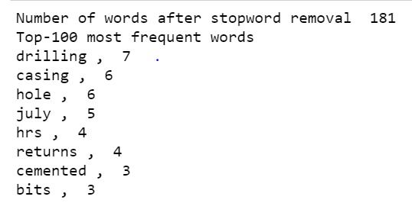
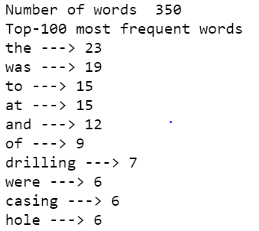
Stop Words Removal
Removal of stopwords from the documents:

Slide 21
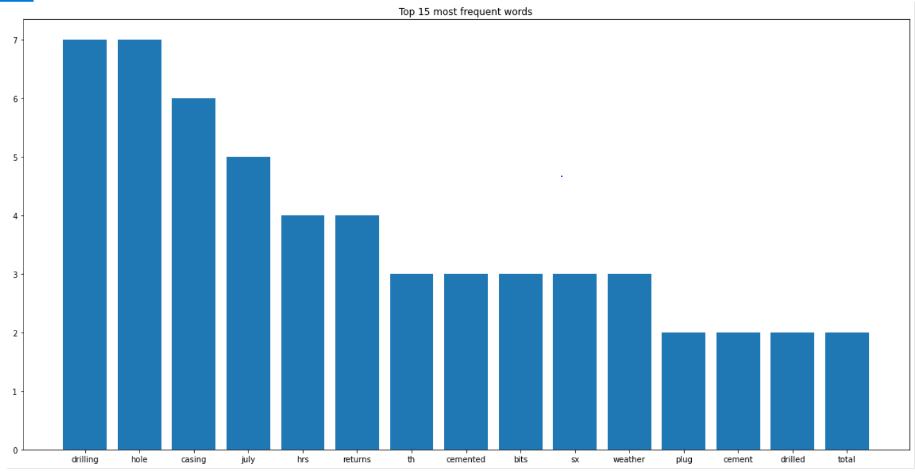
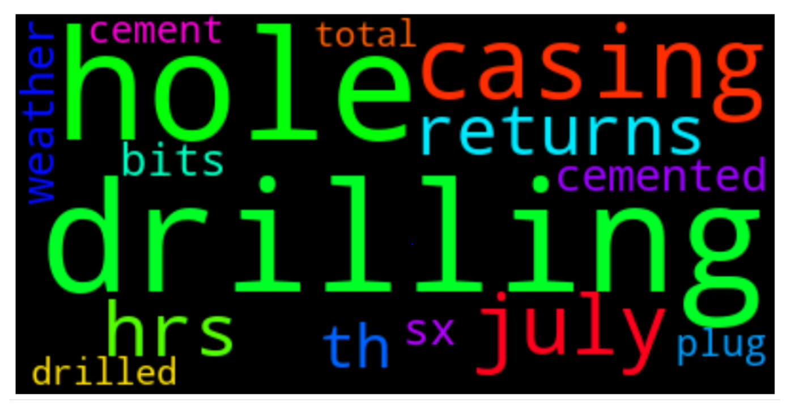
Topic words
Most frequent words used in a page of document:

Slide 22
Thank you for your attention

